Slide 1

Physics 1
Prepared by Engr. Philip Jayson L. Lestojas

Slide 2
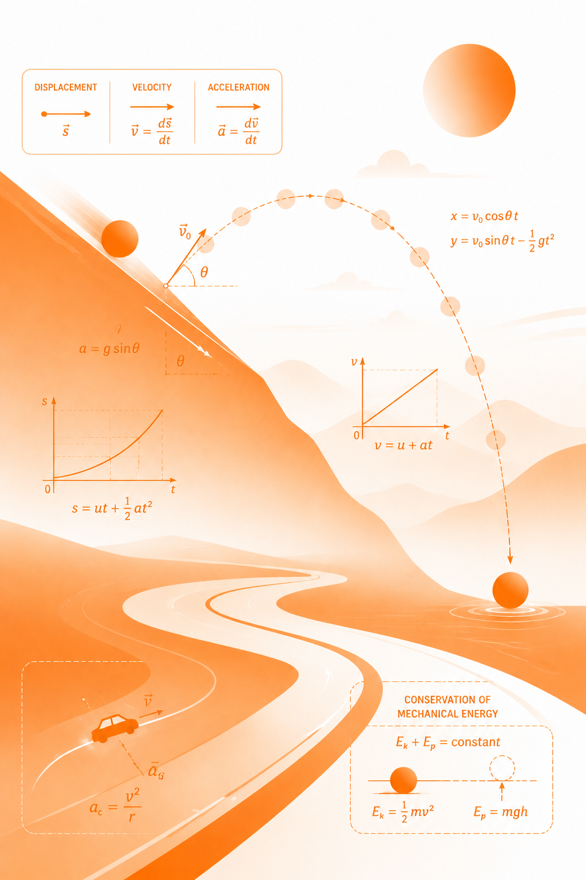
Learning Competency
Define the fundamental quantities and the basis of its SI units.
Physics 1
Prepared by Engr. Philip Jayson L. Lestojas

Slide 3
Learning Objectives
1
Distinguish physical quantities from non-physical properties and identify the primary SI base units used in mechanics.
2
Express physical quantities across varying scales using metric prefixes and scientific notation.
3
Convert units between metric and non-metric systems to solve real-world dimensional problems.
Physics 1
Prepared by Engr. Philip Jayson L. Lestojas

Slide 4
Physical Quantities
Physics relies entirely on objective, measurable properties of our universe.
Physical Quantities are any quantifiable properties of an object or phenomenon that can be measured with an instrument or calculated.
Non-physical properties, such as emotional states or subjective beauty, fall entirely outside the domain of empirical physics because they cannot be assigned a standardized numerical value.
Physics 1
Prepared by Engr. Philip Jayson L. Lestojas
Notes:
Welcome, everyone. Before we can analyze how things move, we must establish a rigorous language for measurement. In physics, if we cannot measure it, we cannot model it. We call these measurable characteristics physical quantities. Think of it this way: a smartphone screen has a physical width, a physical weight, and a physical battery capacity you can read in digits. But how "cool" or "trendy" the phone is cannot be measured by any instrument—meaning it cannot be used in a physics equation.

Slide 5
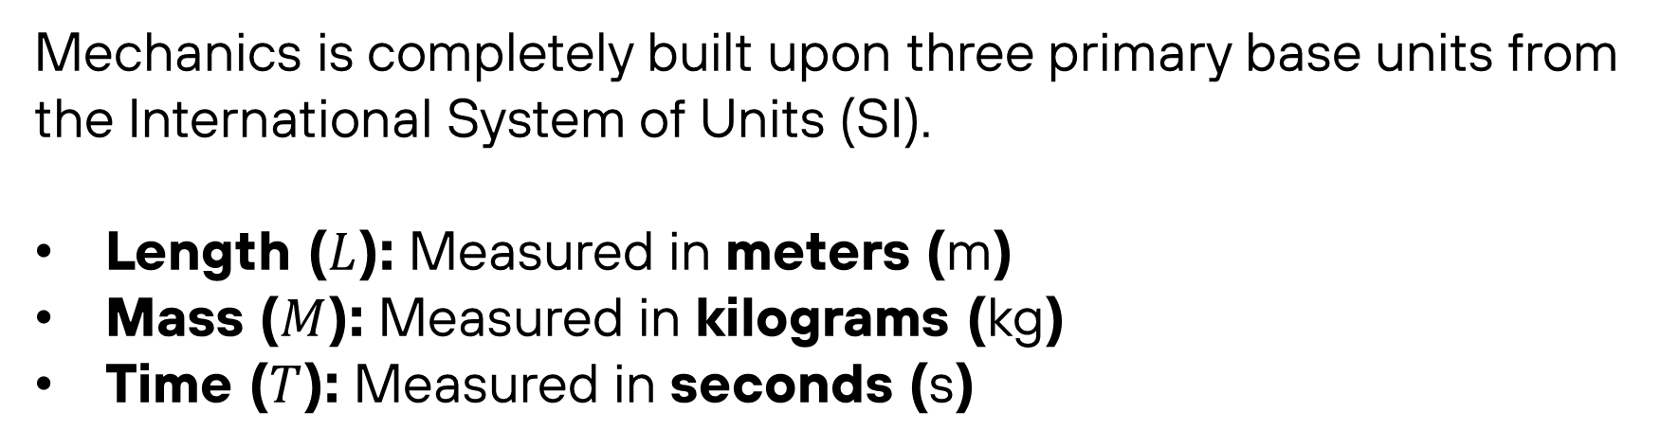
SI Base Units
Mechanics is completely built upon three primary base units from the International System of Units (SI).
Length ($L$): Measured in meters ($\text{m}$)
Mass ($M$): Measured in kilograms ($\text{kg}$)
Time ($T$): Measured in seconds ($\text{s}$)
Physics 1
Prepared by Engr. Philip Jayson L. Lestojas
Notes:
To ensure that a laboratory experiment conducted here yields the exact same calculated results as one conducted across the globe, the scientific community relies on the SI system. For our study of motion, we only need to worry about three absolute baselines: the meter for space, the kilogram for matter, and the second for time. To help build an intuition for these values, our textbook lists handy real-world benchmarks. A football field is around 91 meters long, an adult human has a mass around 100 kilograms, and a single normal human heartbeat takes just under one second.

Slide 6
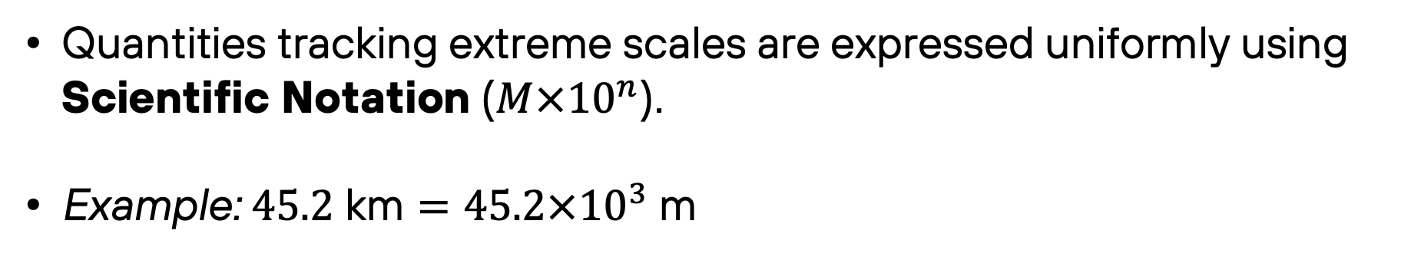
Metric Prefixes
Quantities tracking extreme scales are expressed uniformly using Scientific Notation ($M×{10}^{n}$).
Example: $45.2 \text{km}=45.2×{10}^{3} \text{m}$
Physics 1
Prepared by Engr. Philip Jayson L. Lestojas
Notes:
Physics handles everything from the scale of the cosmos to subatomic particles. To manage these shifts in scale without writing endless rows of zeros, we use standard metric prefixes and scientific notation. When solving problems, treating prefixes as simple multipliers—like swapping the letter 'k' for 'times ten to the third power'—saves you from making easy arithmetic slip-ups.
For numbers \(\ge 10\): Move the decimal point to the left until the coefficient is between \(1\) and \(10\). The exponent becomes positive and equals the number of places the decimal moved.Example: \(12,300\) becomes \(1.23 \times 10^4\) [1, 2]
For numbers \(<1\): Move the decimal point to the right until the coefficient is between \(1\) and \(10\). The exponent becomes negative and equals the number of places the decimal moved.Example: \(0.0045\) becomes \(4.5 \times 10^{-3}\) [1, 2]

Slide 7
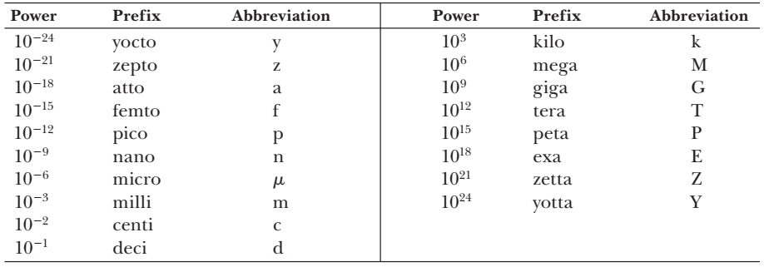
Metric Prefixes
Physics 1
Prepared by Engr. Philip Jayson L. Lestojas

Slide 8
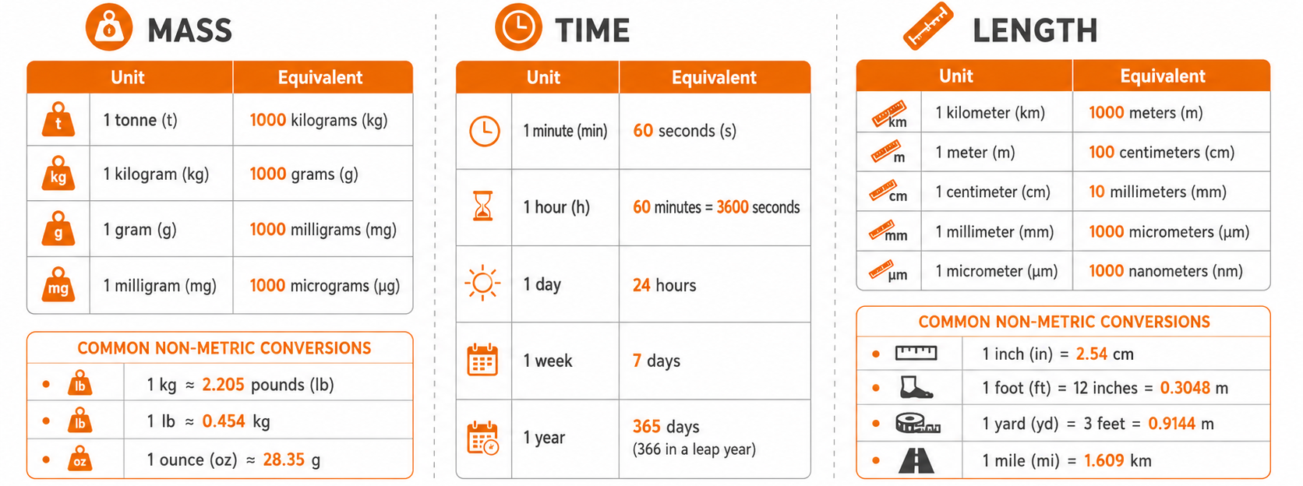
Conversion of Units
1,609 m
Physics 1
Prepared by Engr. Philip Jayson L. Lestojas

Slide 9
Guided Example 1
On an interstate highway, a car is traveling at a speed of 38.0 m/s. Is the driver exceeding the speed limit of 75.0 mi/h?
Reference: Serway, R. A., & Jewett, J. W. (2019). Physics for scientists and engineers with modern physics (10th ed.). Cengage Learning.
Physics 1
Prepared by Engr. Philip Jayson L. Lestojas
Notes:
85 mi/h,
The driver is indeed exceeding the speed limit and should slow down

Slide 10
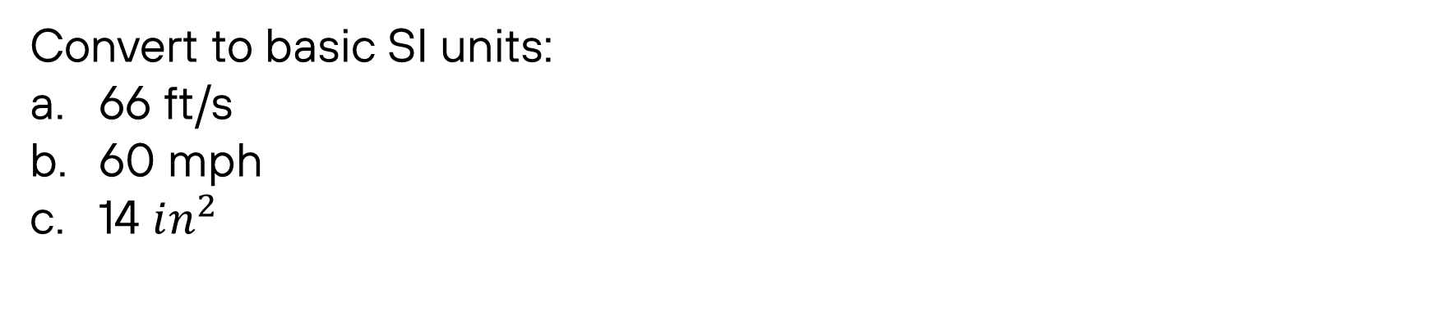
Guided Example 2
Convert to basic SI units:
66 ft/s
60 mph
14 $in^{2}$
Reference: Knight, R. D. (2022). Physics for scientists and engineers: A strategic approach with modern physics (5th ed.). Pearson.
Physics 1
Prepared by Engr. Philip Jayson L. Lestojas
Notes:
85 mi/h,
The driver is indeed exceeding the speed limit and should slow down

